Slide 1

CSE7101- Capstone Project
Review-1
USE OF DIGITAL TECHNOLOGY TO CALCULATE FOOTPRINTS FOR DIFFERENT DAILY USE ITEMS
Batch Number: COM_15
ROLL NUMBER | STUDENTS NAME
20221COM0149 | SUSHMITHA N
20221COM0161 | LATHASHREE
20221COM0184 | RASHMI N
Under the Supervision of,
Mr.Mohamed Shakir
Professor / Associate Professor / Assistant Professor
School of Computer Science and Engineering
Presidency University
Name of the Program: BTech
Name of the HoD: Dr.Pallavi
Name of the Program Project Coordinator: Benitha Christinal J
Name of the School Project Coordinators: Dr. Sampath A K , Dr. Geetha A

Slide 2
Content
Problem Statement
Objectives
Background and Related work
Analysis of Problem Statement
Innovation or Novel Contributions
Git-hub Link
Timeline of the Project
References

Slide 3
Problem Statement Number:PSCS_4
Organization : NGOs, UN-Water, World Resources Institute
Category (Hardware / Software / Both) : Software
Problem Description : Water scarcity is a growing concern, and individuals lack awareness of the water footprint associated with their daily consumption. Existing data is scattered, technical, and difficult to access, while manual methods are complex and non-user-friendly. There is a need for a digital solution that leverages modern technologies to provide simple, localized, and real-time water footprint insights, empowering people to make sustainable choices.

Slide 4
Objectives
To increase public awareness about the concept of water footprint and its impact on sustainability and water scarcity.
To design and develop a user-friendly digital platform (mobile app/website) that can estimate and visualize the water footprint of daily-use products.
To ensure inclusivity by supporting local languages and simple interfaces, making the tool usable across diverse communities in India.
To leverage AI, Big Data, and Blockchain for accurate, transparent, and real-time water footprint calculations and data management.
To create a reliable data source that can assist policymakers, NGOs, and local authorities in planning and implementing water conservation strategies.

Slide 5
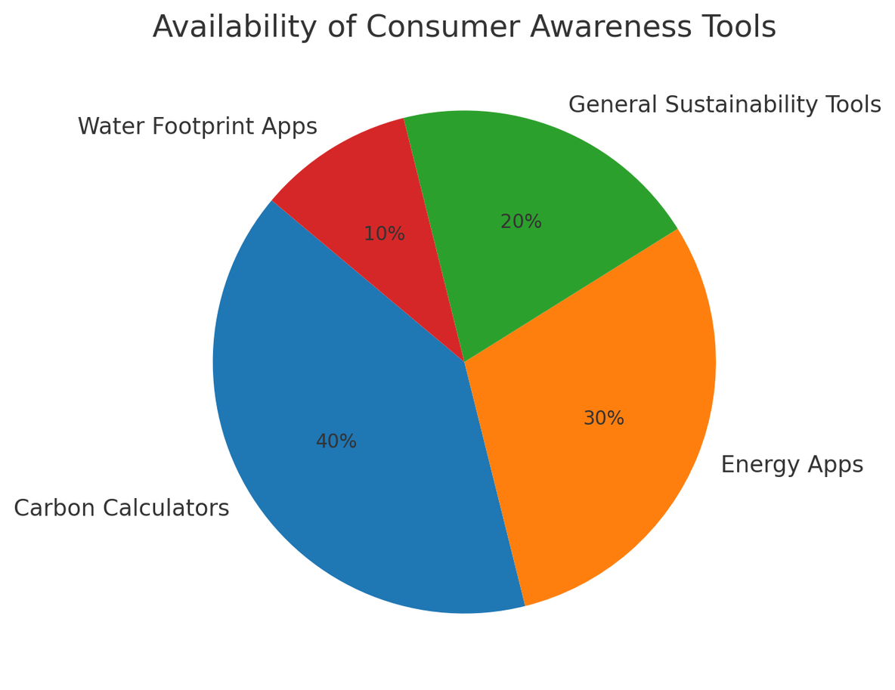
Background and Related work
ISO 14046 and the Water Footprint Network provide methodologies for water footprint assessment.
Most studies focus on agriculture and industry, not everyday consumer products.
Carbon calculators and sustainability apps raise awareness but mainly for carbon footprints.
Very few accessible, user-friendly apps exist for water footprint awareness at the consumer level.

Slide 6
Analysis of Problem Statement (contd...)
Input:
-Product details (name, barcode, or category).
-User data (location, consumption pattern).
-Camera input (scan like Google Lens).
.
Output:
-Estimated water footprint (total + Green, Blue, Grey split).
-Comparison and visualization (graphs, basket view).
-Personalized insights and recommendations.
Challenges:
-Limited availability of region-specific datasets.
-Integrating diverse data sources (agriculture, industry, products).
-Balancing accuracy with simplicity for end-users.

Slide 7
Analysis of Problem Statement (contd...)
Innovation / Novel Contributions
Consumer-Centric Focus – brings water footprint awareness to everyday users, not just researchers.
Green / Blue / Grey Categorization – clear breakdown of water use types.
AI + Camera Recognition – scan products for instant footprint estimation.
Localized Multi-Language Support – ensures accessibility across regions.
Personalized Insights & Basket View – compare multiple items at once.
Blockchain Transparency – reliable and tamper-proof water footprint data.
Interactive Visualizations – easy-to-understand graphs and reports.

Slide 8
Analysis of Problem Statement (contd...)
Technology Stack Components
Frontend: JavaScript (React.js) or Python (Streamlit for prototype).
Backend: Python (FastAPI / Flask).
Database: SQL (PostgreSQL / SQLite).
Visualization: Python (Plotly, Matplotlib) or JavaScript (Recharts).
Mobile Option: Kotlin (Android).

Slide 9
Analysis of Problem Statement (contd...)
Software: Python, React.js, SQL, PostgreSQL/SQLite, Plotly/Recharts, GitHub, Heroku/AWS.
Hardware: Min: i3, 4 GB RAM, 128 GB SSD; Recommended: i5/i7, 8–16 GB RAM, 512 GB SSD.

Slide 10
GitHub Link
https://github.com/Rashmi83-colab

Slide 11
Timeline of the Project (Gantt Chart)

Slide 12
References (IEEE Paper format)
H. Gerbens-Leenes, A. Y. Hoekstra, and T. Van der Meer, “The water footprint of energy from biomass: A quantitative assessment and consequences of an increasing share of bio-energy in energy supply,” Ecological Economics, vol. 68, no. 4, pp. 1052–1060, Feb. 2009.
A. S. Shrestha, P. Shukla, and R. K. Gupta, “Blockchain-based solutions for sustainable water management,” IEEE Access, vol. 10, pp. 12548–12560, Feb. 2022.
L. Zhang, K. Li, and H. Wang, “Big data-driven approaches for environmental sustainability,” IEEE Transactions on Big Data, vol. 7, no. 3, pp. 456–468, Jun. 2021

Slide 13


